Slide 1




CUSTOMER
SEGMENTATION
Unlocking Insights for Business Growth
Presented By:
Farida Hamid

Slide 2



WHY DATA MATTERS
Understand the Dataset
Gain a comprehensive overview of the online retail dataset, including customer transactions, product information, and sales behavior to identify relevant features for analysis.
With thousands of transactions and products, it's impossible to detect patterns manually.
By leveraging data analysis and clustering, we uncover valuable customer segments and business opportunities.
Data Cleaning & Preparation
Clean the dataset by removing missing, duplicate, or irrelevant entries (e.g., non-product codes), correct data types, and engineer useful features to ensure accurate analysis and modeling.
Perform EDA
Use statistical summaries and visualizations to uncover trends such as top-selling products, country-wise distribution, and seasonal purchase patterns, providing a foundation for deeper insights.
Customer Segmentation
Apply RFM (Recency, Frequency, Monetary) analysis to group customers based on purchasing behavior, and use clustering algorithms to identify actionable customer segments.

Slide 3

The dataset consists of online retail transactions including invoice numbers, products, quantities, unit prices, and customer IDs. Before analysis, we explored its structure and patterns to ensure quality insights. Several issues like cancellations, negative values, and data skewness were identified and handled appropriately.
UNDERSTANDING DATASET
Data Structure
Cancellations & Negative Values
Each row represents a transaction tied to a specific invoice, product description, quantity, and price. Some entries reflect purchases, while others are administrative or financial in nature.
Invoices starting with ‘C’ typically indicate canceled orders. These often appear with negative quantities or prices, showing items that were returned or adjusted
(35.86% of the unique invoices )
Non-Product Entries
Data Skewness
Some descriptions, such as "POSTAGE", "DISCOUNT", "SAMPLES", or "BANK CHARGES", represent logistics or financial adjustments rather than actual product purchases. These entries serve important back-office or shipping purposes.
Numerical fields like Unit price and Quantity show right-skewed distributions, meaning most customers make modest purchases while a few contribute to large values. This reflects the typical imbalance found in real-world transaction data.

Slide 4

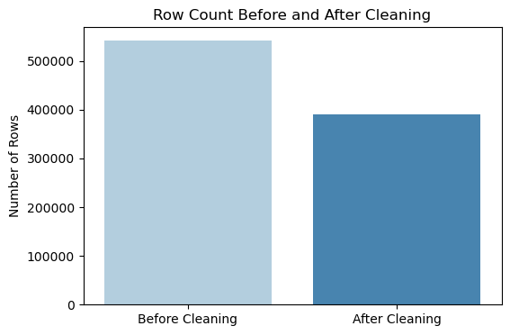
DATA CLEANING
Before performing clustering and customer segmentation, we applied multiple cleaning steps to improve data quality. This included handling missing values, excluding administrative records, filtering invalid transactions, and applying transformation to reduce skewness — all aiming to reflect true purchasing behavior.
Missing & Invalid Entries
Non-Product Descriptions
Removed rows with missing CustomerID or Description, as they’re essential for identifying unique customers and product behaviors, and dropped transactions with Quantity ≤ 0 or UnitPrice ≤ 0
Excluded rows with terms like:
"POSTAGE", "DISCOUNT", "SAMPLES", "BANK CHARGES", these represent financial adjustments, not actual customer purchases.
Cancelled Orders
Reducing Impact of Extremes
Dropped invoices with IDs starting with 'C', indicating cancelled or returned items. These typically include negative quantities or prices and distort behavior patterns.
Applied log1p transformation to Quantity and UnitPrice.This helped normalize right-skewed distributions and improve clustering input quality without removing outliers.

Slide 5
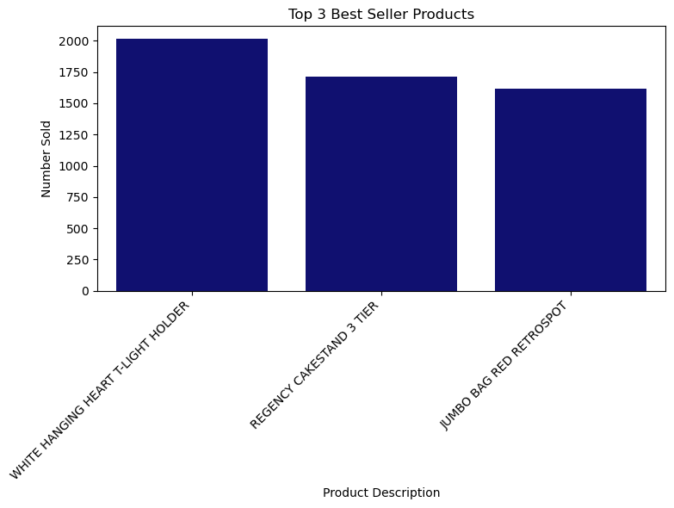
CUSTOMER
DISTRIBUTION INSIGHTS
We analyzed customer origins and product sales to uncover concentration patterns. The majority of purchases come from the United Kingdom, while only a small fraction is distributed among other countries. A few key products dominate sales volume, indicating a highly skewed product demand.
93% of orders come from the UK
Top 3 selling products:
White Hanging Heart T-Light Holder
Regency Cakestand 3 Tier
Jumbo Bag Red Retrospot
Our top 5 customers account for nearly 6.5% of all orders

Slide 6
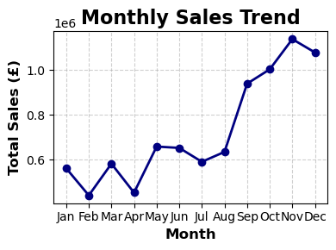
TEMPORAL & BEHAVIORAL PATTERNS
Time-based analysis highlights seasonal purchasing behavior, with strong peaks around the holiday season. Moreover, the majority of customers purchase only once, suggesting a need for improved customer retention strategies.
Sales peak in November and December.
Low sales in January post-holidays.
The sales is more in the working days than the weekends
Most customers buy low quantities and low-cost items.

Slide 7

SEGMENTATION STRATEGY: RFM ANALYSIS
To group customers meaningfully, we applied RFM analysis a widely used approach in marketing analytics that segments customers based on three key behavioral metrics: Recency, which measures how recently a customer made a purchase; Frequency, which captures how often they make purchases; and Monetary, which reflects how much they spend in total. This method helps identify valuable patterns in customer behavior and supports targeted engagement strategies.
Why RFM?
How It Works?
Helps identify loyal, at-risk, and high-value customers
Simple but powerful metric-based approach
Widely used in customer retention and targeting campaigns
We calculated RFM scores for each customer
Applied K-Means clustering on normalized RFM values
Grouped customers into 3 key segments based on similarity

Slide 8


CUSTOMER SEGMENTATION INSIGHTS
Based on RFM values, customers were grouped into three distinct segments. These segments highlight differences in purchasing behavior, frequency, and value enabling targeted strategies for engagement, retention, and growth.
Loyal Customers
Mid-Tier Customers
Highest spending group (avg. £661)
Shop frequently (avg. 12 times)
Purchased recently (avg. 14 days ago)
Customers: 895
Shop occasionally (avg. 3 times)
Moderate recency (avg. 60 days ago)
Spend less than Cluster 0 (avg. £171)
Customers: 1,701
At-Risk Customers
Longest inactive (avg. 166 days)
Purchase only once
Lowest spenders (avg. £46)
Customers: 1,738

Slide 9
BUSINESS IMPACT & STRATEGIC RECOMMENDATIONS
Focus on High-Value Customers (Cluster 0)
Offer loyalty perks, early access, or premium bundles.
Our customer segmentation and sales analysis revealed valuable business insights that can drive targeted strategies. With £8.7M in total revenue from 18,400 orders, and an average order value of £474, the business shows strong potential. However, based on behavioral patterns and RFM clustering, key opportunities exist to enhance performance and retention.
Re-engage At-Risk Customers (Cluster 2)
Send targeted win-back emails and time-limited discounts.
Optimize Order Value
Recommend related products or incentivize second purchases.
Leverage Seasonal Peaks
Introduce bundled products or minimum free shipping thresholds to increase average order size.

Slide 10
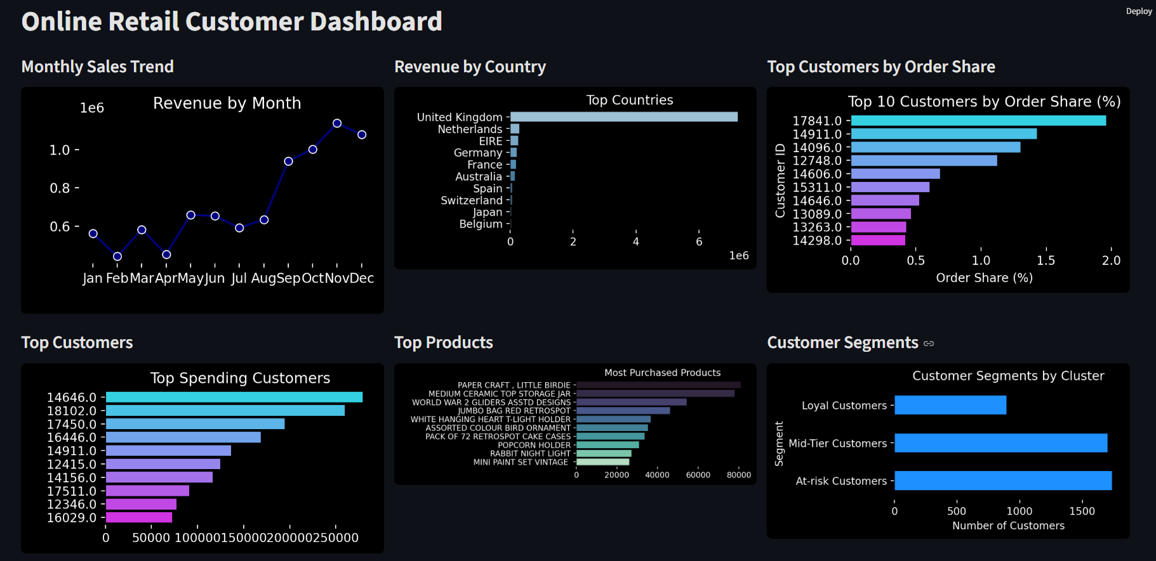
Dashboard

Slide 11

THANK YOU
For Your Attention

